Slide 1
The year in .NET Security

Slide 2

Who am I?
Barry Dorrans
Security PM

Slide 3
Vulnerability vocabulary
1

Slide 4
CVEs
A uniform standard for identifying and reporting security vulnerabilities.
https://www.cve.org/
Notes:
CVE = Common Vulnerabilities and Exposures

Slide 5
CVSS
CVSS is not a measure of risk.
v3 score calculated from exploitability and impact metrics.
As a framework we score based on the worst possible scenario.
https://nvd.nist.gov/vuln-metrics/cvss
Notes:
CVSS = Common Vulnerability Scoring System, scored from 0 – 10.
Calculated from
Exploitability metrics: Attack Vector: (Network, Adjacent network, Local, Physical)
Attack Complexity: (Low, Medium High)
Privileges required (None, Low, High)
User Interaction: (None, Required)
Scope: (Unchanged, changed)
Impact metrics: Confidentiality: (None/Low/High)
Integrity: (None/Low/High)
Availability: (None/Low/High)

Slide 6
CWD
A list of common software and hardware weaknesses.
Usually introduced by developers.
https://cwe.mitre.org/
Notes:
CWE = Common Weakness Enumeration

Slide 7
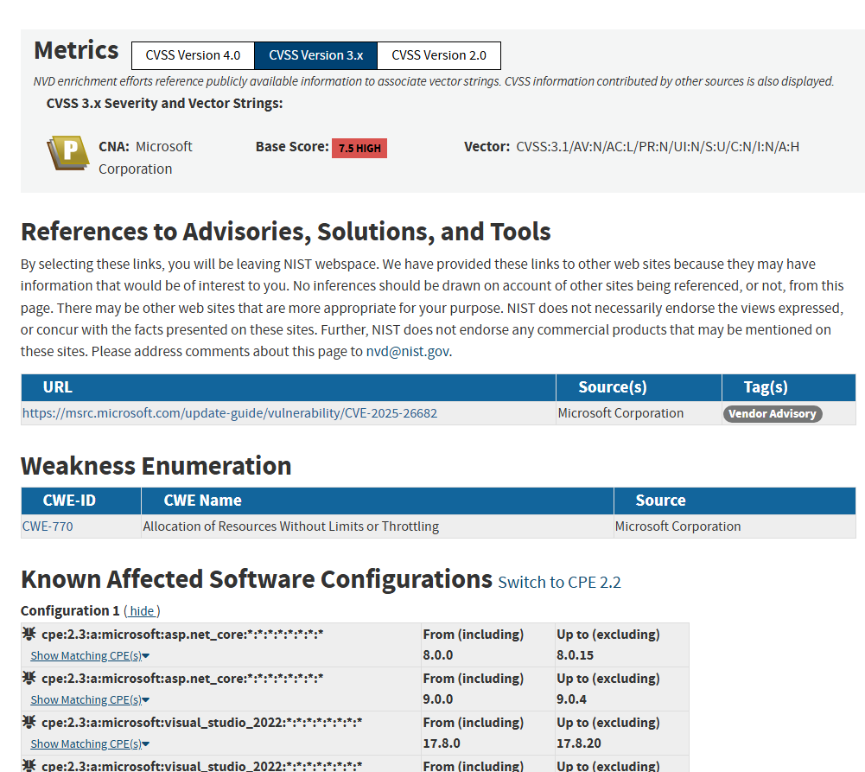
CVE-2025-26682
For example,
https://nvd.nist.gov/vuln/detail/CVE-2025-26682
Notes:
CVSS Vector
Version 3.1
Exploitability metrics
AV: N – Attack Vector = Network
AC: L – Attack Complexity = Low
PR: N – Privileges Required = None
UI: N – User Interaction = None
S: U – Scope = Unchanged
Impact metrics
C: N – Confidentiality = None
I: M – Integrity = None
A: H – Availability = High

Slide 8
This year in vulnerabilities
2

Slide 9



Reports, Patches and Pay
84
12
$93,000
Reports to MSRC
CVEs
Bounty Paid
Notes:
Highest bounty payout - $65k
Lowest - $3k (docs issue)

Slide 10
Sounds low?
Not all valid MSRC reports get CVEs.
We issue for medium CVSS and above.
There are more security fixes made behind the scenes.
Notes:
We issue CVEs when you must act (patching usually).
Docs issues and sample code issues don’t get CVEs because we take the action of updating the docs or the samples.
Some things are just normal bugs, not security bugs. Some things get rated low, which become “fix in next version” bugs.

Slide 11
.NET CVEs, 1 to 6
.NET CVEs
1 of 2
01
02
03
04
05
06
CVE-2025-55248
CVE-2025-55247
CVE-2025-30399
CVE-2025-26646
CVE-2025-21173
CVE-2025-21172
Information Disclosure
A MITM (man in the middle) attacker may prevent use of TLS between client and SMTP server, forcing client to send data over unencrypted connection.
Denial-of-Service
A vulnerability exists in .NET where predictable paths for MSBuild's temporary directories on Linux could lead to DoS of builds.
Remote Code Execution
Exploitable by placing files in particular locations, leading to unintended code execution.
Spoofing
A vulnerability exists in .NET SDK or MSBuild applications where external control of file name or path allows an unauthorized attacked to perform spoofing over a network.
Elevation of Privilege
Exploitable by writing a specially crafted file in the security context of the local system. This only affects .NET on Linux operating systems.
Remote Code Execution
Exploitable by loading a specially crafted file in Visual Studio.

Slide 12
.NET CVEs, 7 to 9
.NET CVEs
2 of 2
07
08
09
CVE-2025-21171
CVE-2024-43499
CVE-2024-43498
Remote Code Execution
Exploitable by sending a specially crafted request to the vulnerable web app.
Denial of Service
The NrbfDecoder component in .NET 9 contains a denial-of-service vulnerability due to incorrect input validation.
Remote Code Execution
Exploitable by sending specially crafted requests to a .NET vulnerable webapp or loading a specially crafted file into a vulnerable application.

Slide 13
ASP.NET CVEs
01
02
03
CVE-2025-55315
CVE-2025-26682
CVE-2025-24070
Security Feature Bypass
HTTP Request Smuggling vulnerability.
Denial-of-Service
DoS in ASP.NET’s HTTP/3 stack.
Elevation of Privilege
RefreshSignInAsync() did not authenticate properly.

Slide 14
Vulnerabilities by type
Vulnerabilities by type
FY25
Notes:
RCE 4
DoS 2
Spoofing 1
EoP 3
Security Feature Bypass 1
Information Disclosure 1

Slide 15
Vulnerabilities by CVSS
Vulnerabilities by CVSS
FY25
Notes:
Medium (4.0 - 6.9) 1
High (7.0 - 8.9) 9
Critical (9.0 - 10) 2

Slide 16
The year in .NET CVEs
3

Slide 17

Caution
The fix author may not have written the vulnerable code!

Slide 18
.NET Vulnerability details
01
Information Disclosure
02
Denial-of-Service
03
Remote Code Execution
04
Spoofing
05
Elevation of Privilege
06
Remote Code Execution
07
Remote Code Execution
08
Denial-of-Service
09
Remote Code Execution

Slide 19



CVE-2025-55248
Information Disclosure
Description
Bug
The fix
A MITM (man in the middle) attacker may prevent use of TLS between client and SMTP server, forcing client to send data over unencrypted connection.
SmtpClient may connect without TLS even if UseSsl is true.
An attacker that sat between the application and the SMTP server could then see all traffic, including email contents, disclosing information.
Add missing check inside SendHello() so it fails when UseSSL is true.
https://github.com/dotnet/runtime/commit/615ee7dcf32cef6e42d6427723cb4c14ca56989a
Notes:
The EHLO (extended hello) command is an extension of HELO introduced in the Extended SMTP (ESMTP) protocol, defined in RFC 5321. It is used to identify the client and to inform the server that the client supports ESMTP. The server responds with a list of supported ESMTP features, which includes STARTTLS.
If a server doesn’t support EHLO it falls back to HELO, which does not support TLS

Slide 20
CVE-2025-55247
.NET Denial of Service
Description
Bug
The fix
A vulnerability exists in .NET where predictable paths for MSBuild's temporary directories on Linux let another user create the directories ahead of MSBuild, leading to DoS of builds. This only affects .NET on Linux operating systems.
The temp directory on Linux is writable by everyone, unlike Windows where you get a user specific temp directory.
As MSBuild used predictable paths an attacker on Linux could create the directory it used, and deny access to it, resulting in MSBuild giving up, a denial of service.
Use Directory.CreateTempSubdirectory()
not File.GetTempPath().
https://github.com/dotnet/msbuild/pull/12688
Notes:
Search your own code for File.GetTempPath() and replace it with Directory.CreateTempSubdirectory().

Slide 21
CVE-2025-30399
.NET Remote Code Execution
Description
Bug
The fix
An attacker could exploit this vulnerability by placing files in particular locations, leading to unintended code execution.
If a non-.NET application hosted .NET via COM, C++/CLI or some type of custom hosting coreclr could be loaded from the current working directory, rather than the trusted install location.
Why is this remote code execution? The application could be started from a network share, which is “remote” to the local machine.
Remove a fallback path in Comhost.cs where apps with no .deps.json which caused .NET to look for coreclr in the current working directory.
https://github.com/dotnet/runtime/pull/116504

Slide 22
CVE-2025-26646
.NET Spoofing Vulnerability
Description
Bug
The fix
A vulnerability exists in .NET SDK or MSBuild applications where external control of file name or path allows an unauthorized attacked to perform spoofing over a network.
The DownloadFile task in MSBuild ceded too much control to the remote server, allowing it to choose the filename of the file being downloaded.
Allowing the server to choose a filename is categorized as spoofing.
Ignore the Content-Disposition header, and use the filename specified in the task, or generate one from the URL specified in the task.
https://github.com/dotnet/msbuild/pull/11864
Notes:
Treat responses from to any http request as untrusted. Don’t allow responses to specify things like filenames. The Context-Disposition header can even include paths, which is even more dangerous.

Slide 23
.NET / NuGet restore operations use the temporary directory to store a deps.json file containing paths to dependencies. On Linux, as previously seen, that is writable by all, so an attacker on a machine could change the paths in the file to point to their own packages.
The attacker running code they control under another user process could be Elevation of Privilege if the other process is elevated, or root or Administrator.
CVE-2025-211713
.NET Elevation of Privilege
Description
Bug
The fix
An attacker could exploit this vulnerability to writing a specially crafted file in the security context of the local system. This only affects .NET on Linux operating systems.
As before, move to the Directory.CreateTempSubdirectory() API.
https://github.com/dotnet/sdk/commit/e6c1ca796a9bed0ad8beefa3e30f961ed3b59fcf

Slide 24
The Microsoft Debug Interface Access SDK (MSDIA) is used by .NET to enhance stack traces.
It had an RCE vector when opening symbols and memory dumps.
CVE-2025-21172
.NET Remote Code Execution
Description
Bug
The fix
An attacker could exploit this vulnerability by loading a specially crafted file in Visual Studio.
Update the version of MSDIA we ship with .NET.

Slide 25
CVE-2025-21171
.NET Remote Code Execution
Description
Bug
The fix
An attacker could exploit this vulnerability by sending a specially crafted request to the vulnerable web server.
Unsafe code in Convert.ToHexString() calculated a buffer length incorrectly, leading to a buffer overflow.
Buffer overflows allow an attacker to write memory they should not have access to.
The worst-case scenario is the memory could contain executable instructions something else calls, which means RCE.
destination.Length >
source.Length * 2
change to
destination.Length <
source.Length * 2
https://github.com/dotnet/runtime/pull/109891
Notes:
Check your maths. Fuzz your APIs. Stop using Unsafe code.

Slide 26
CVE-2024-43498
.NET Remote Code Execution
Description
Bug
The fix
A remote unauthenticated attacker could exploit this vulnerability by sending specially crafted requests to a .NET vulnerable webapp or loading a specially crafted file into a vulnerable application.
Type confusion in the “safe” .NET Remoting Binary Format reader could cause an access violation.
Access violations are when code tries to access memory it should not have access to.
The worst-case scenario is that it the NBRF reader accesses and then executes code in a memory space an attacker controls, which means RCE.
For a multi-dimensional array of IEnumerable there was an expectation of a specific record type, ClassRecord, but as string implements IEnumerable the array could contain a StringRecord. Remove the assumption and added extra type checks.
https://github.com/dotnet/runtime/pull/110194
Notes:
NBRF stands for .NET Remoting: Binary Format
When you are expecting a type don’t assume, validate the type.

Slide 27
CVE-2024-43499
.NET Denial of Service
Description
Bug
The fix
The NrbfDecoder component in .NET 9 contains a denial-of-service vulnerability due to incorrect input validation.
An NRBF “document” containing a small jagged array would allocate a large amount of memory (a 90-byte payload would allocate 50Gb).
Obviously, this is a denial of service.
Rewrite jagged array handling.
https://github.com/dotnet/runtime/pull/110194

Slide 28
The year in ASP.NET Core CVEs
4

Slide 29
CVE-2025-24070
Elevation of Privilege in ASP.NET Core
Description
Bug
The fix
A vulnerability exists in ASP.NET Core applications calling RefreshSignInAsync with an improperly authenticated user parameter that could allow an attacker to sign into another user's account, resulting in Elevation of Privilege.
The email change confirmation treated the user id in the change confirmation link as trusted and signed the user in.
This meant if someone got hold of an email change confirmation link and used it before the intended user they were authenticated as the user, elevating their privilege from anonymous to authenticated.
Change how RefreshSignInAsync() was used in the ConfirmEmailChange pages to use the current logged in user, rather than the user specified in the link Uri.
https://github.com/dotnet/aspnetcore/pull/60881

Slide 30
CVE-2025-26682
Denial-of-Service in ASP.NET Core
Description
Bug
The fix
A vulnerability exists in ASP.NET Core when using HTTP/3 improperly may result in a Denial of Service by allocation of resources without limits or throttling.
HTTP/3 frame parsing had an unbounded memory growth bug
Frame data wasn’t processed until the entire frame came in, which meant limits were never hit. An attacker could start multiple frames saying they were going to be 100Mb, send 100Mb-1 and the 100MB would get allocated for reads and sit there waiting for the last byte.
Change how HTTP Frames are parsed, making it clearer that it parses based on remaining length and adding support for partial frames.
https://github.com/dotnet/aspnetcore/pull/61414
Notes:
If you’re adhering to an RFC check it carefully. Fuzz your logic. Make sure you have timeouts when you listen for things, validate they work, validate that they work when something stops in the middle of an operation, or slows down and trickles (Slow Loris attack)

Slide 31
Bug
CVE-2025-55315
Security Feature Bypass in ASP.NET Core
Description
The fix
Inconsistent interpretation of http requests ('http request/response smuggling') in ASP.NET Core allows an authorized attacker to bypass a security feature over a network.
The HTTP parser incorrectly accepted control characters, specifically newline (\n) characters, within chunk extensions, violating the HTTP/1.1 specification.
The worst possible case was you could have a kestrel system parsing requests, and passing them on to a second system, which used different parsing code and would see the smuggled request as a separate request, trusting Kestrel got it right. This could enable auth bypasses, SSRF etc., depending on your architecture.
Change the parser to detect and reject requests with \n in chunk extensions.
https://github.com/dotnet/aspnetcore/pull/64037
Notes:
If you’re adhering to an RFC check it carefully. Watch for MUST and SHOULD clauses. SHOULD is an indication that the logic could be undefined. MAY is even worse, it might work, it might not.
Strict adherent can also be problematic. Kestrel started out as strict adherence to all the relevant RFCs but it couldn’t be adopted by internal partners because of that, as their existing web servers were not strict and we’d reject requests they received

Slide 32
Bug Bounty
Please report Vulnerabilities & Security bugs to MSRC, not in GitHub issues. https://msrc.microsoft.com/report/vulnerability
If you do, I may have to write you a cheque.
https://aka.ms/corebounty

Slide 33
Thank you
Notes:
And don’t forget you have a year before .NET 8 and .NET 9 go out of support, so start your upgrades now, so you can keep going those security updates.

